Slide 1



Conversational
Agent Implementation
SI-II MP2
Beatriz Costa
Luís Silva
Pedro Carvalho
Tiago Pinho
Intro
1
2
3
4
End
Notes:
Bea

Slide 2
Table of Contents
Introduction
Types of
Chatbots
Conversational Chatbot
Access
Access
Access
Action-based Chatbot
Chatbot
Merge
Conclusion
Access
Access
Access
Intro
1
2
3
4
End
Notes:
Bea

Slide 3
Chatbot
”a computer program designed to have a conversation with a human being, especially over the internet”
Cambridge Dictionary
Intro
1
2
3
4
End
Notes:
Bea

Slide 4
Introduction
Applications on the fields of education, business and e-commerce, health and entertainment
Commonly seen in the business field since they reduce service costs and can handle many customers simultaneously
At the end of 2016, thirty-four thousand of chatbots were spread across many fields
Some famous examples are ELIZA, PERRY, ALICE, SmarterChild, Siri, Alexa, …
Intro
1
2
3
4
End
Notes:
Bea

Slide 5


Types of Chatbots
Task-oriented
or
Rule-based
Data-driven and Predictive
Intro
Rule-Based
AI-based
Our
Choice
Intro
1
2
3
4
End
Notes:
Tiago

Slide 6
Task-oriented or Rule-based Chatbot
Generate automatic conversational responses to user inquiries.
Considered first approach of implementation of this specific programs. They look through pattern matches in the users’ speech and if the input cannot fit into a rule, it gives an inaccurate answer.
Intro
Rule-based
AI-based
Our
choice
Intro
1
2
3
4
End
Notes:
Tiago

Slide 7
Data-driven and Predictive
Chatbot
Also referred to as virtual assistants.
They apply predictive intelligence and monitor data and intents
of the user, also being able to initiate conversations by themselves.
Learn from existing datasets from the most various backgrounds.
Intro
Rule-based
AI-based
Our
Choice
Intro
1
2
3
4
End
Notes:
Tiago

Slide 8
Our choice
Merge both approaches
Enables the chatbot to answer to actions queried by the user and/or have a conversation
Uses natural language processing
and for grammatically incorrect sentences, or sentences not supported by the system, reacts in a ”seemingly intelligent” way
Intro
Rule-based
AI-based
Our
Choice
Intro
1
2
3
4
End
Notes:
Tiago

Slide 9
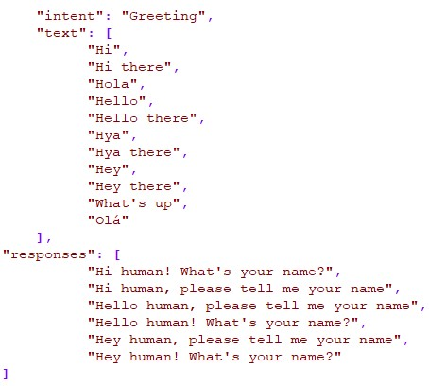
Datasets
Conversational Chatbot
Chatbots: Intent Recognition Dataset
- Has a big variation of intents and density of inputs and responses - Added more data to make the training of the Chatbot more complete
- Removed unused parts of the data
Datasets
Intents
Feedback
Intro
1
2
3
4
End
Notes:
Bea

Slide 10
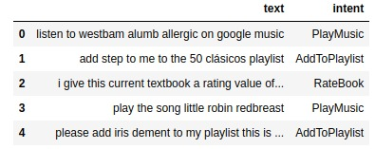
Datasets
Action-based
Chatbot
- Recognizes seven intents originally
- Examples/intents can be added if desired
Datasets
Intents
Feedback
Intro
1
2
3
4
End
Notes:
Bea

Slide 11
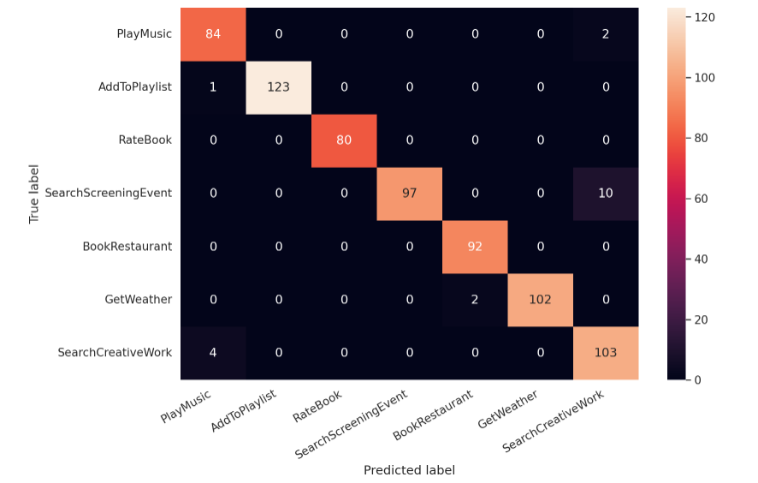
Intent Recognition
Conversational & Action-based
Tokenizing & Padding
Feed the input to the model
Predict intent
Datasets
Intents
Feedback
Intro
1
2
3
4
End
Notes:
Pedro

Slide 12

Feedback
Conversational
Chatbot remembers the name of the user if told to and
will be able to call it when asked or when he intends to.
The Chatbot answers when asked about the time
After a prediction, randomly chooses a response correspondent
to the predicted intent
The Chatbot focuses on a normal conversation with the user
Datasets
Intents
Feedback
Intro
1
2
3
4
2
End
Notes:
Bea

Slide 13

Feedback
Action-based
Uses Spacy's Named entity recognition capabilities
to retrieve key information in the input
If key elements are missing the user is prompted for them
Key elements are defined on an Intent-by-Intent basis
Supports APIs (Spotify, Google, IPMA, …)
Datasets
Intents
Feedback
Intro
1
2
3
4
2
End
Notes:
Tiago

Slide 14

Merge
Conversational & Action-based
Action + Conversational
Keywords : ”conversation” , ”action”, ”wrong”, ”bye ”
Speech recognition solution for communication
Merge
Strenghts
Limitations
Demos
Intro
1
2
3
4
End
Notes:
Luís

Slide 15

Strenghts
Conversational & Action-based
Chatbot grows through usage
Can integrate APIs
Joins capabilities of both agents
Merge
Strenghts
Limitations
Demos
Intro
1
2
3
4
3
End
Notes:
Luís

Slide 16



Limitations
Conversational & Action-based
Limited Dataset
Input Corrections
Internet Connection
Chatbot grows
through usage, few examples create problems
Need to manually input the corrections so the Chatbot can learn
We need to establish a stable connection in order to use the APIs
Merge
Strenghts
Limitations
Demos
Intro
1
2
3
4
3
End
Notes:
Luís

Slide 17
Demonstration
Conversational & Action-based
Chatbots
Merge
Strenghts
Limitations
Demos
Intro
1
2
3
4
End
Notes:
Luís

Slide 18

Conclusion & Future Work
Small dataset causes the results sometimes to not be
very accurate for both approaches
With constant improvement and increase of the size
of the dataset better results can be anticipated
In a future approach, we want to separate the training
of BERT from the system program execution
Intro
1
2
3
4
End
Notes:
Bea

Slide 19
THANKS!
We are happy to now answer your questions!
Intro
1
2
3
4
End
Notes:
Bea

